Slide 1
Microservices and AWS Lambda - Simplified
Aritra Sarkar
Jishnu Kumar Srivastava
Shivam Tripathi

Slide 2
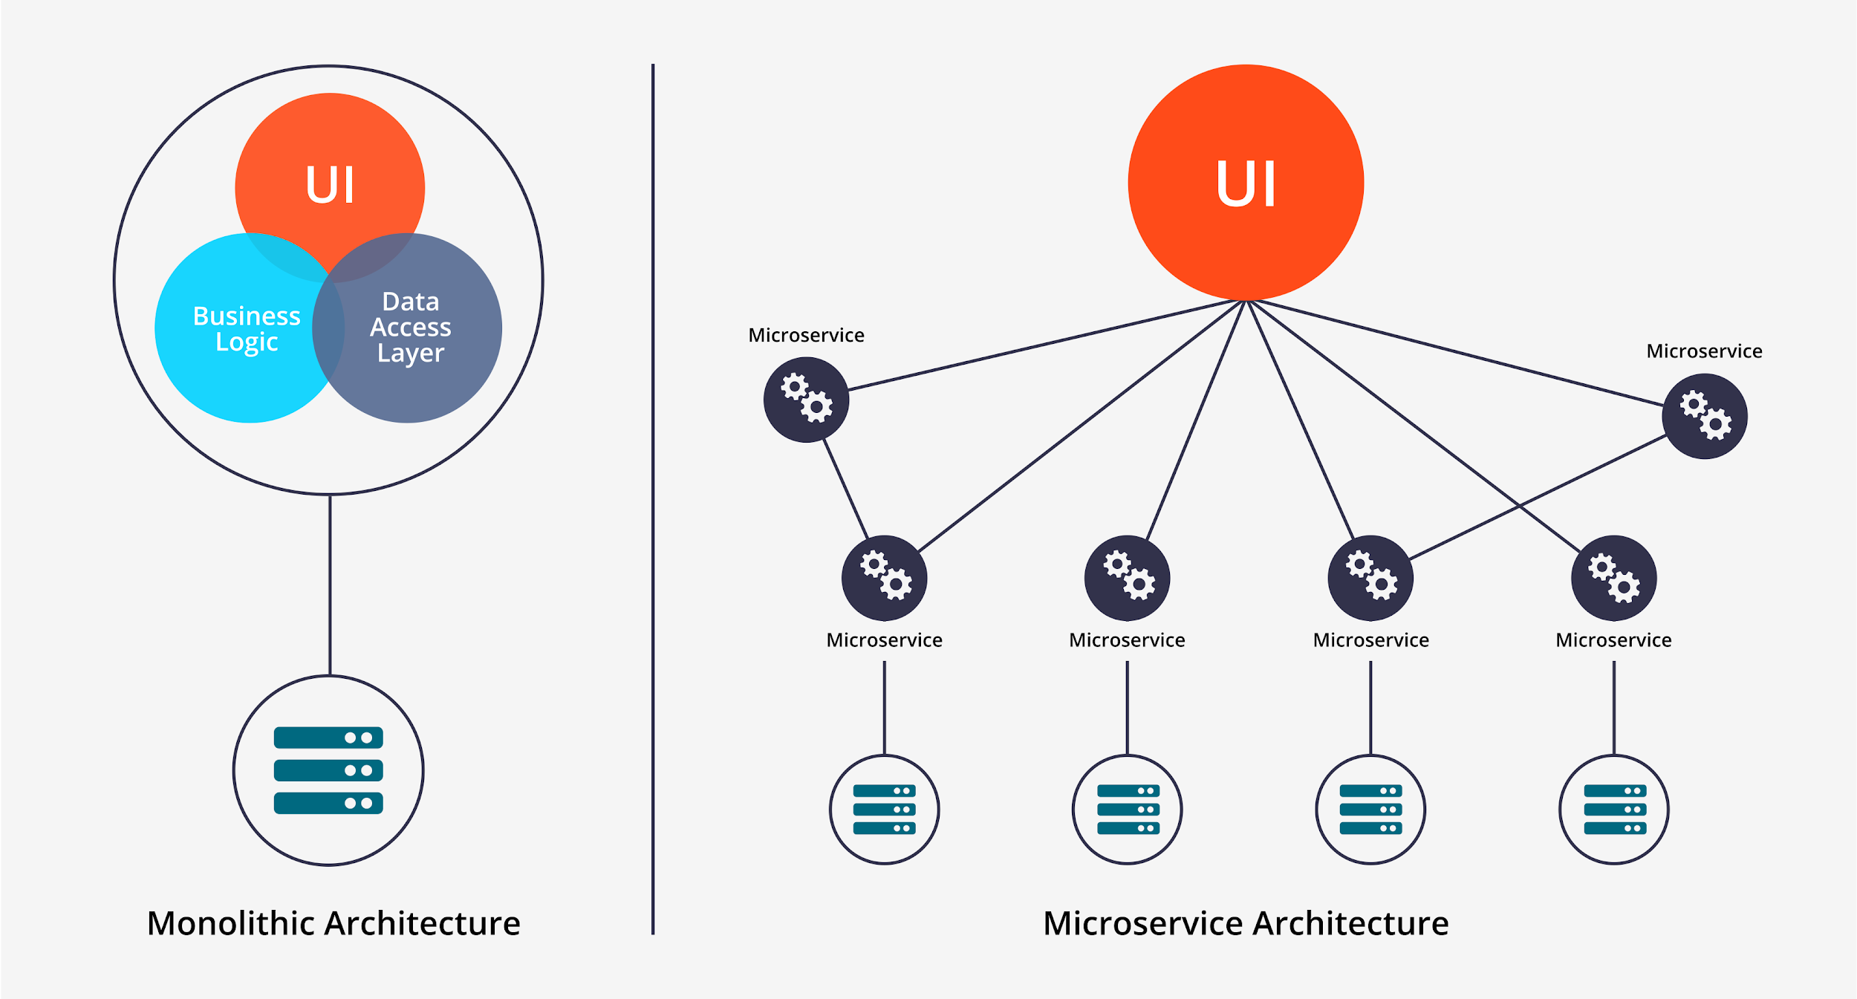
What are Microservices?
Notes:
Microservices are a way of building software systems that are composed of small, independent services which perform a specific function and can be developed and deployed independently and that communicate with each other over a network.
In Monolithic Architecture, usually all things are developed in one application including UI components, Business Logic, and Data Access Layer. And usually that application is deployed on one server node.
However, microservice architecture split Business Logic and Data Access Layer into several small part called Microservices. Real business logic and Data access are implemented by invoking multiple different microservices distributed on different nodes.

Slide 3
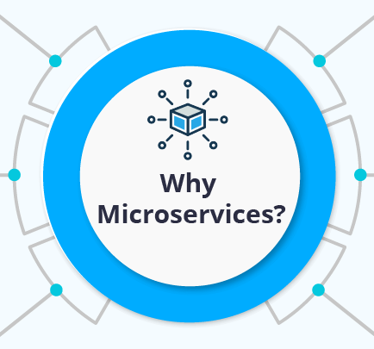
Agility
Flexible Scaling
Easy Deployment
Technological Freedom
Reusable Code
Resilience
Notes:
- Microservices architecture fosters a more agile and flexible organization by empowering small, independent teams to take ownership of their services, allowing for faster decision making and quicker delivery of new features.
- Each service can be independently scaled to meet demand, hence flexible scaling.
- Continuous integration and delivery, promoting experimentation and efficient rollback in case of failure; makes deployment easy.
-Technological freedom is achieved as teams can choose the best tool for their specific problems.
-Reusable code and the ability to bootstrap off previous services results in efficient development.
-The decentralized nature of microservices enhances the resilience of applications, allowing for degraded functionality instead of a complete crash in case of service failure.

Slide 4
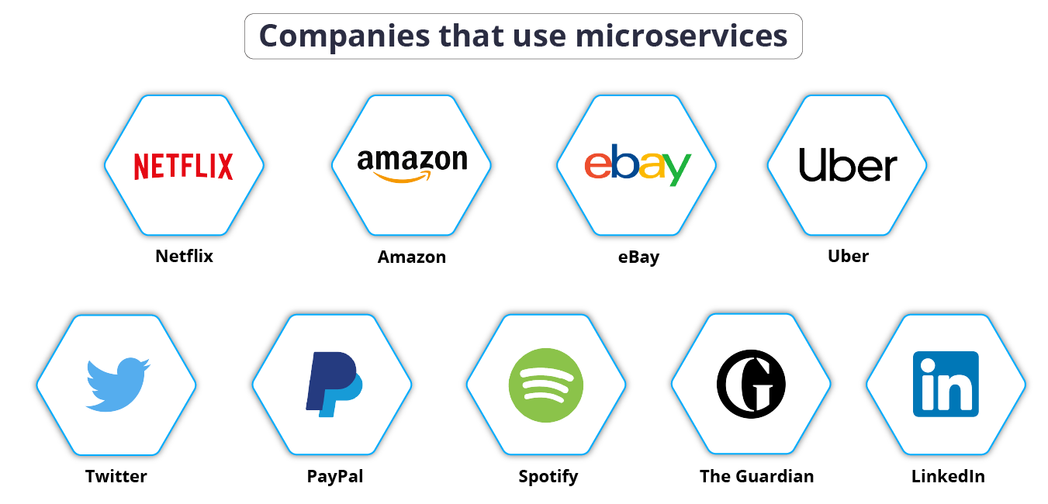

Bajaj Finserv

Slide 5

AWS Lambda
AWS Lambda is a serverless computing service that allows you to run code without provisioning or managing servers.
The code you write is organized into Lambda Functions. Lambda runs your function only when needed and scales automatically, according to. You pay only for the compute time that you consume—there is no charge when your code is not running. Your code runs in response to events, such as changes to data in a database or changes to a file in an S3 bucket.
It can be used to build and deploy Microservices quickly and easily.
Notes:
- What do we mean by serverless computing service? : Serverless computing is a cloud computing execution model in which the cloud provider is responsible for executing a piece of code by dynamically allocating the resources and they are charged by the usage and not by some fixed amount.

Slide 6
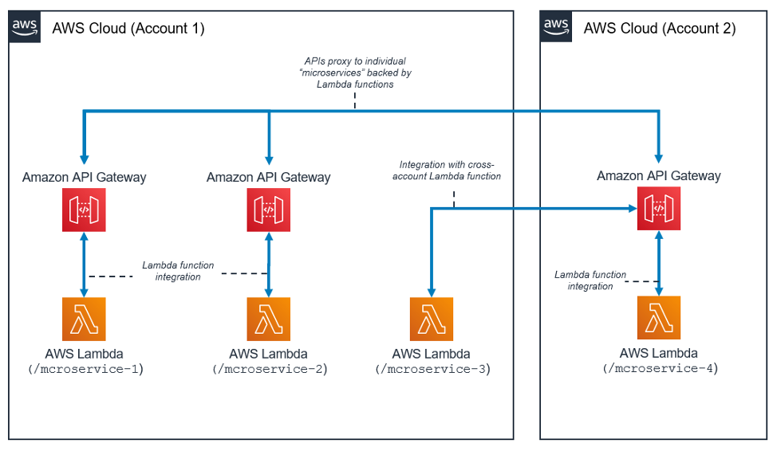
Working of microservices with lambda

Slide 7
Lambda Features
Concurrency and scaling controls
Functions defined as container images
Code signing
Function blueprints
Notes:
- Concurrency and scaling controls: Concurrency limits and provisioned concurrency gives fine-grained control over the scaling and responsiveness of production applications.
- Functions defined as container images: We can use container image tooling, workflows, and dependencies to build, test, and deploy your Lambda functions.
- Code signing: This provides trust and integrity controls that let you verify that only unaltered code that approved developers have published is deployed in your Lambda functions.
Function blueprints: Blueprints provide sample code showing how to use Lambda with other AWS services or third-party applications, include sample code and function configuration presets for Node.js and Python runtimes.
Some other features include : Lambda Extensions, Database access and File System access.

Slide 8
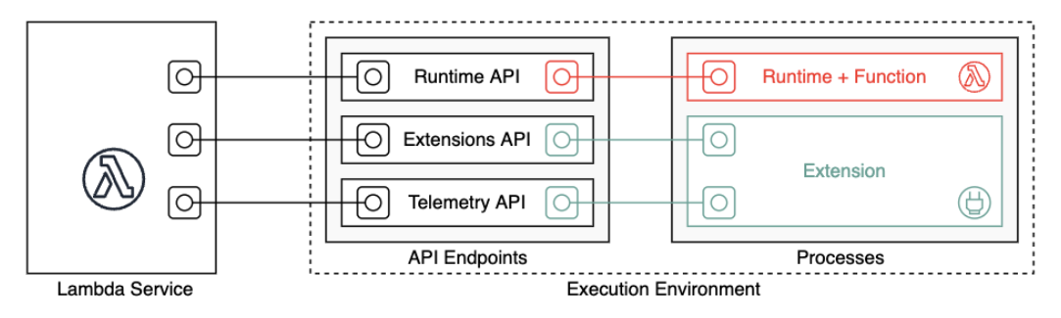
Lambda Execution Environment
The execution environment manages the resources required to run the function, and lifecycle support for the function's runtime and any external extensions associated with the function.
Notes:
- When you create your Lambda function, you specify configuration information, such as the amount of memory available and the maximum execution time allowed for your function. Lambda uses this information to set up the execution environment.
- The function's runtime and each external extension are processes that run within the execution environment. Permissions, resources, credentials, and environment variables are shared between the function and the extensions.

Slide 9
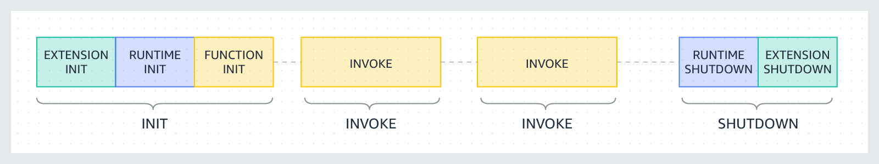
Lambda Execution Environment Lifecycle
Notes:
- Lambda sends an event to the runtime, the completion is indicated by sending a Next API request and when there are no pending events Lambda freezes the execution environment.
- In the Init phase, Lambda: Starts all extensions (Extension init); Bootstraps the runtime (Runtime init); Runs the function's static code (Function init).
- Invoke Phase: When a Lambda function is invoked in response to a Next API request, Lambda sends an Invoke event to the runtime and to each extension. The function's timeout setting limits the duration of the entire Invoke phase. The invoke phase ends after the runtime and all extensions signal that they are done by sending a Next API request.
- Shutdown Phase: When Lambda is about to shut down the runtime, it sends a Shutdown event to each registered external extension. Extensions can use this time for final clean up tasks. The Shutdown event is a response to a Next API request. After the function and all extensions have completed, Lambda maintains the execution environment for some time in anticipation of another function invocation. In effect, Lambda freezes the execution environment. When the function is invoked again, Lambda thaws the environment for reuse.

Slide 10
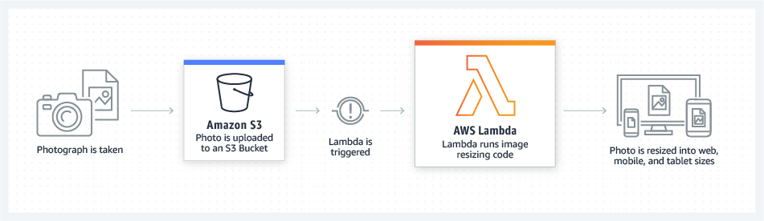
How it Works: File Processing
Notes:
Simple Storage Service (S3)

Slide 11
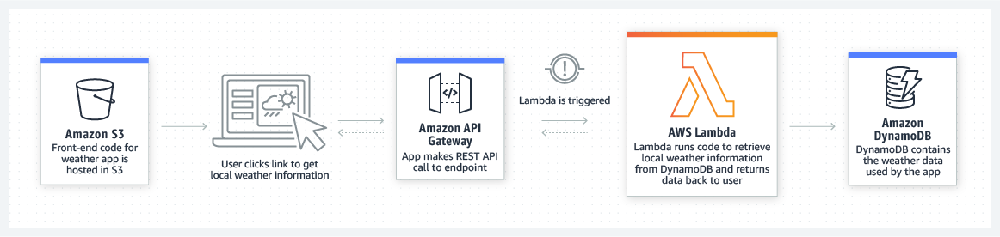
How it Works: Web Applications

Slide 12
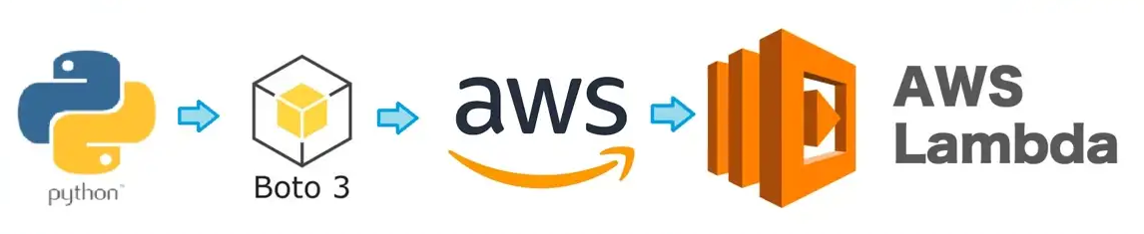
Building Lambda Functions with Python
Lambda provides runtimes for Python that run the code(s) to process events.
The code runs in an environment that includes Boto3 (SDK for Python), with credentials from an AWS Identity and Access Management (IAM) role that you manage.
Boto3 integrates easily with S3, EC2, DynamoDB and APIs.
Notes:
S3 – Simple Storage Service
EC2 – Elastic Computing

Slide 13
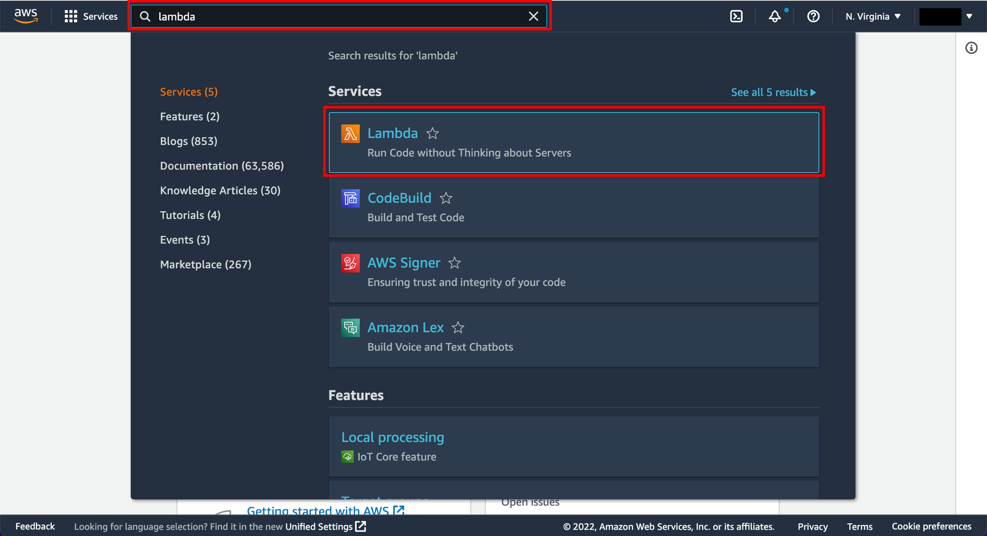
Run a Serverless “Hello, World!”
1. Enter the Lambda Console
Notes:
- Now, that we have got a lot of information on lambda, its features, the execution environment; let us understand how we can run our very own serverless lambda function.
- The very first step is to have an AWS account. A free tier works for this. You need to search for Lambda and open the AWS Lambda console.

Slide 14
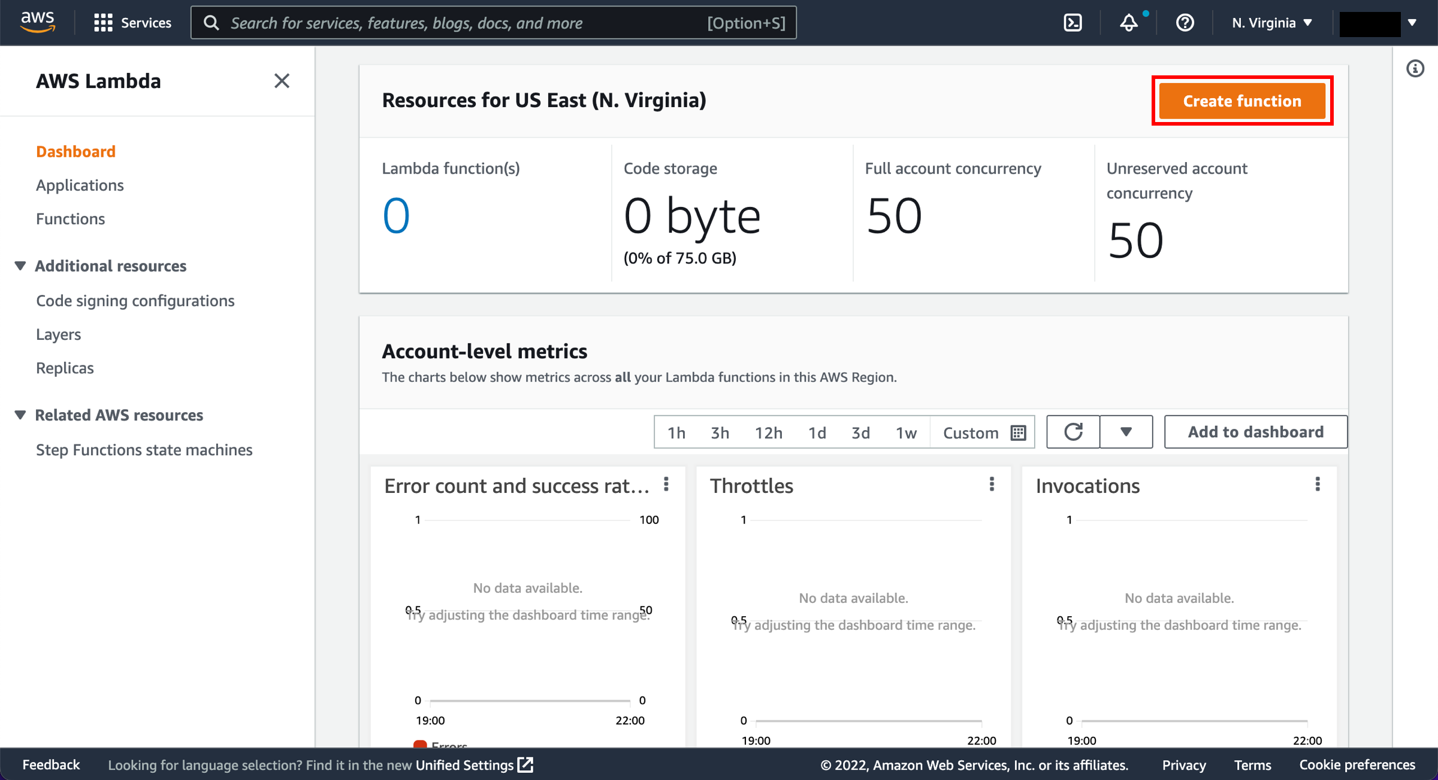
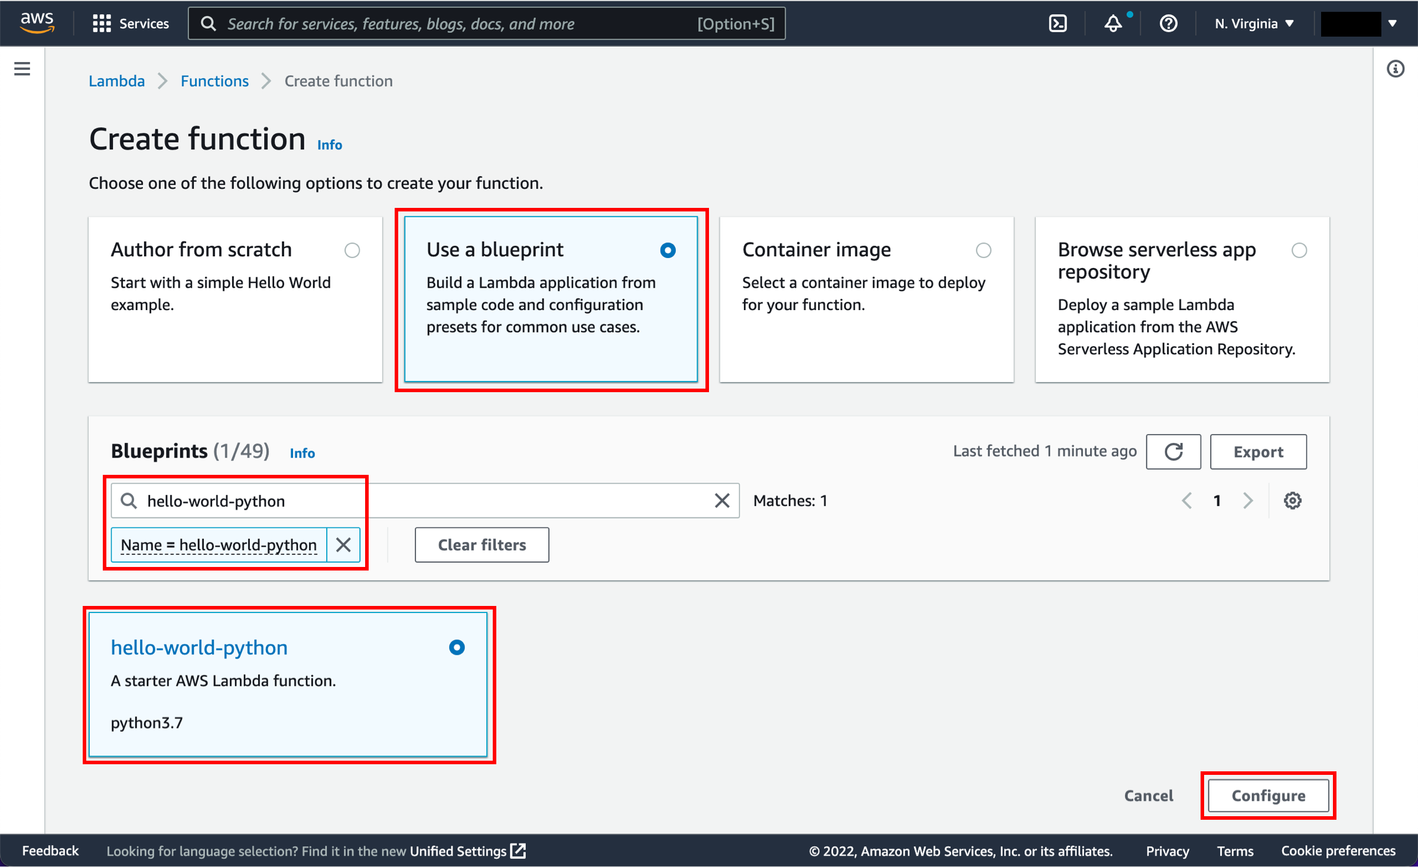
Run a Serverless “Hello, World!”
2. Implementation
Notes:
a. In the AWS Lambda console, choose Create function.
<click>
b. Select use a blueprint. c. In the Filter box, enter hello-world-python and select the hello-world-python blueprint. d. Then choose Configure.

Slide 15
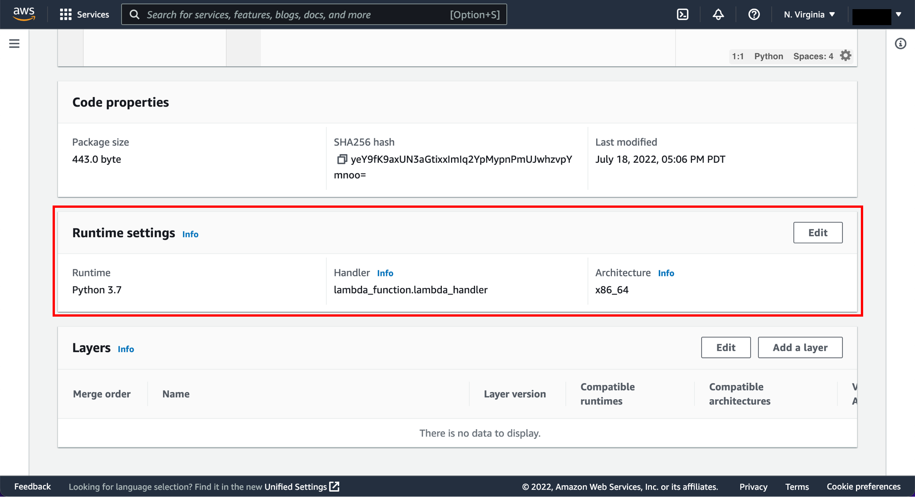
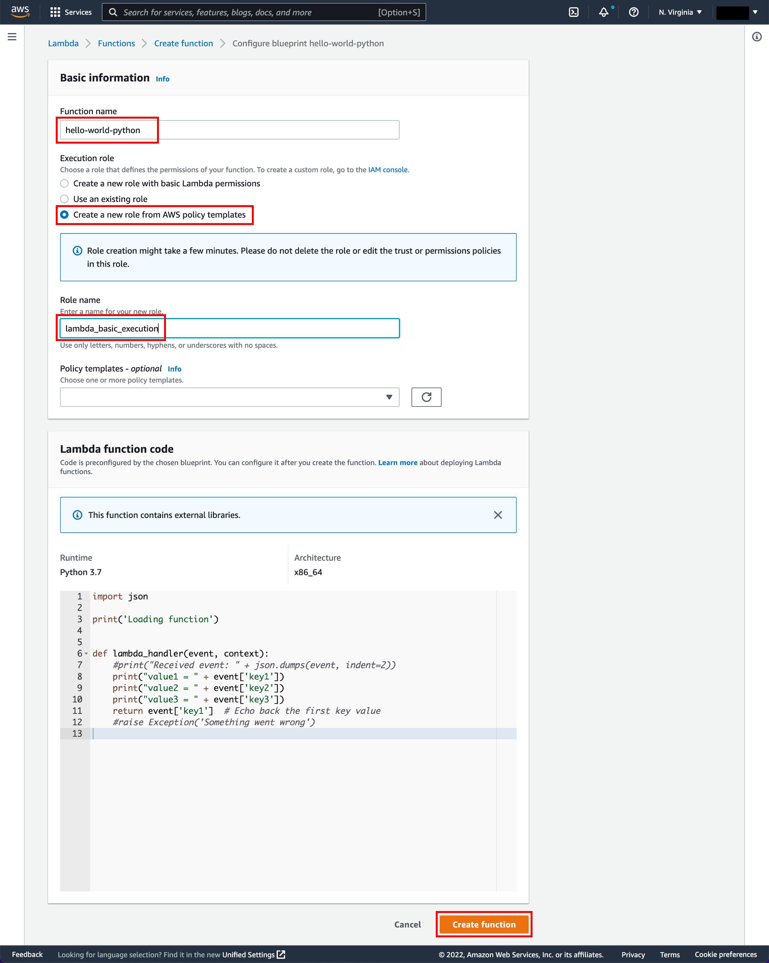
Run a Serverless “Hello, World!”
3. Configure and Create Lambda Function
Notes:
You then enter the basic information such as the function name, the IAM role which grants it certain permissions and the role name.
Following this the lambda function will be created.
The code looks something as such. Now the create function is clicked.
<click>
Following this you will choose the Runtime type, the Handler(a method/function in your code) where AWS Lambda can begin executing your code) and the Architecture type.

Slide 16
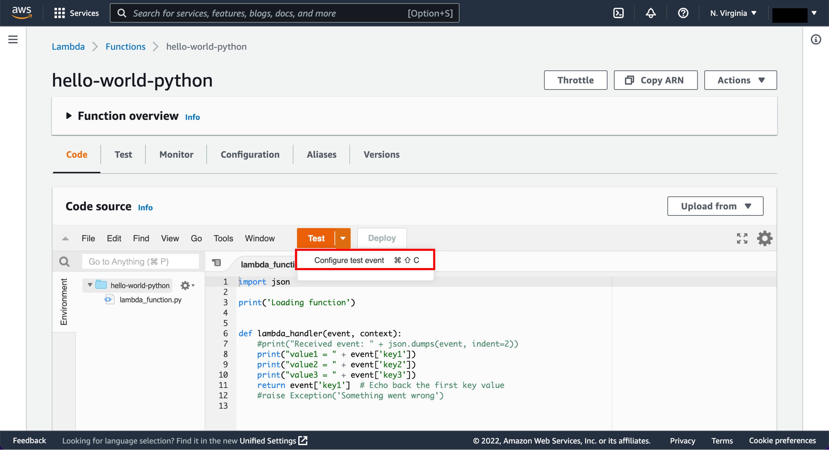
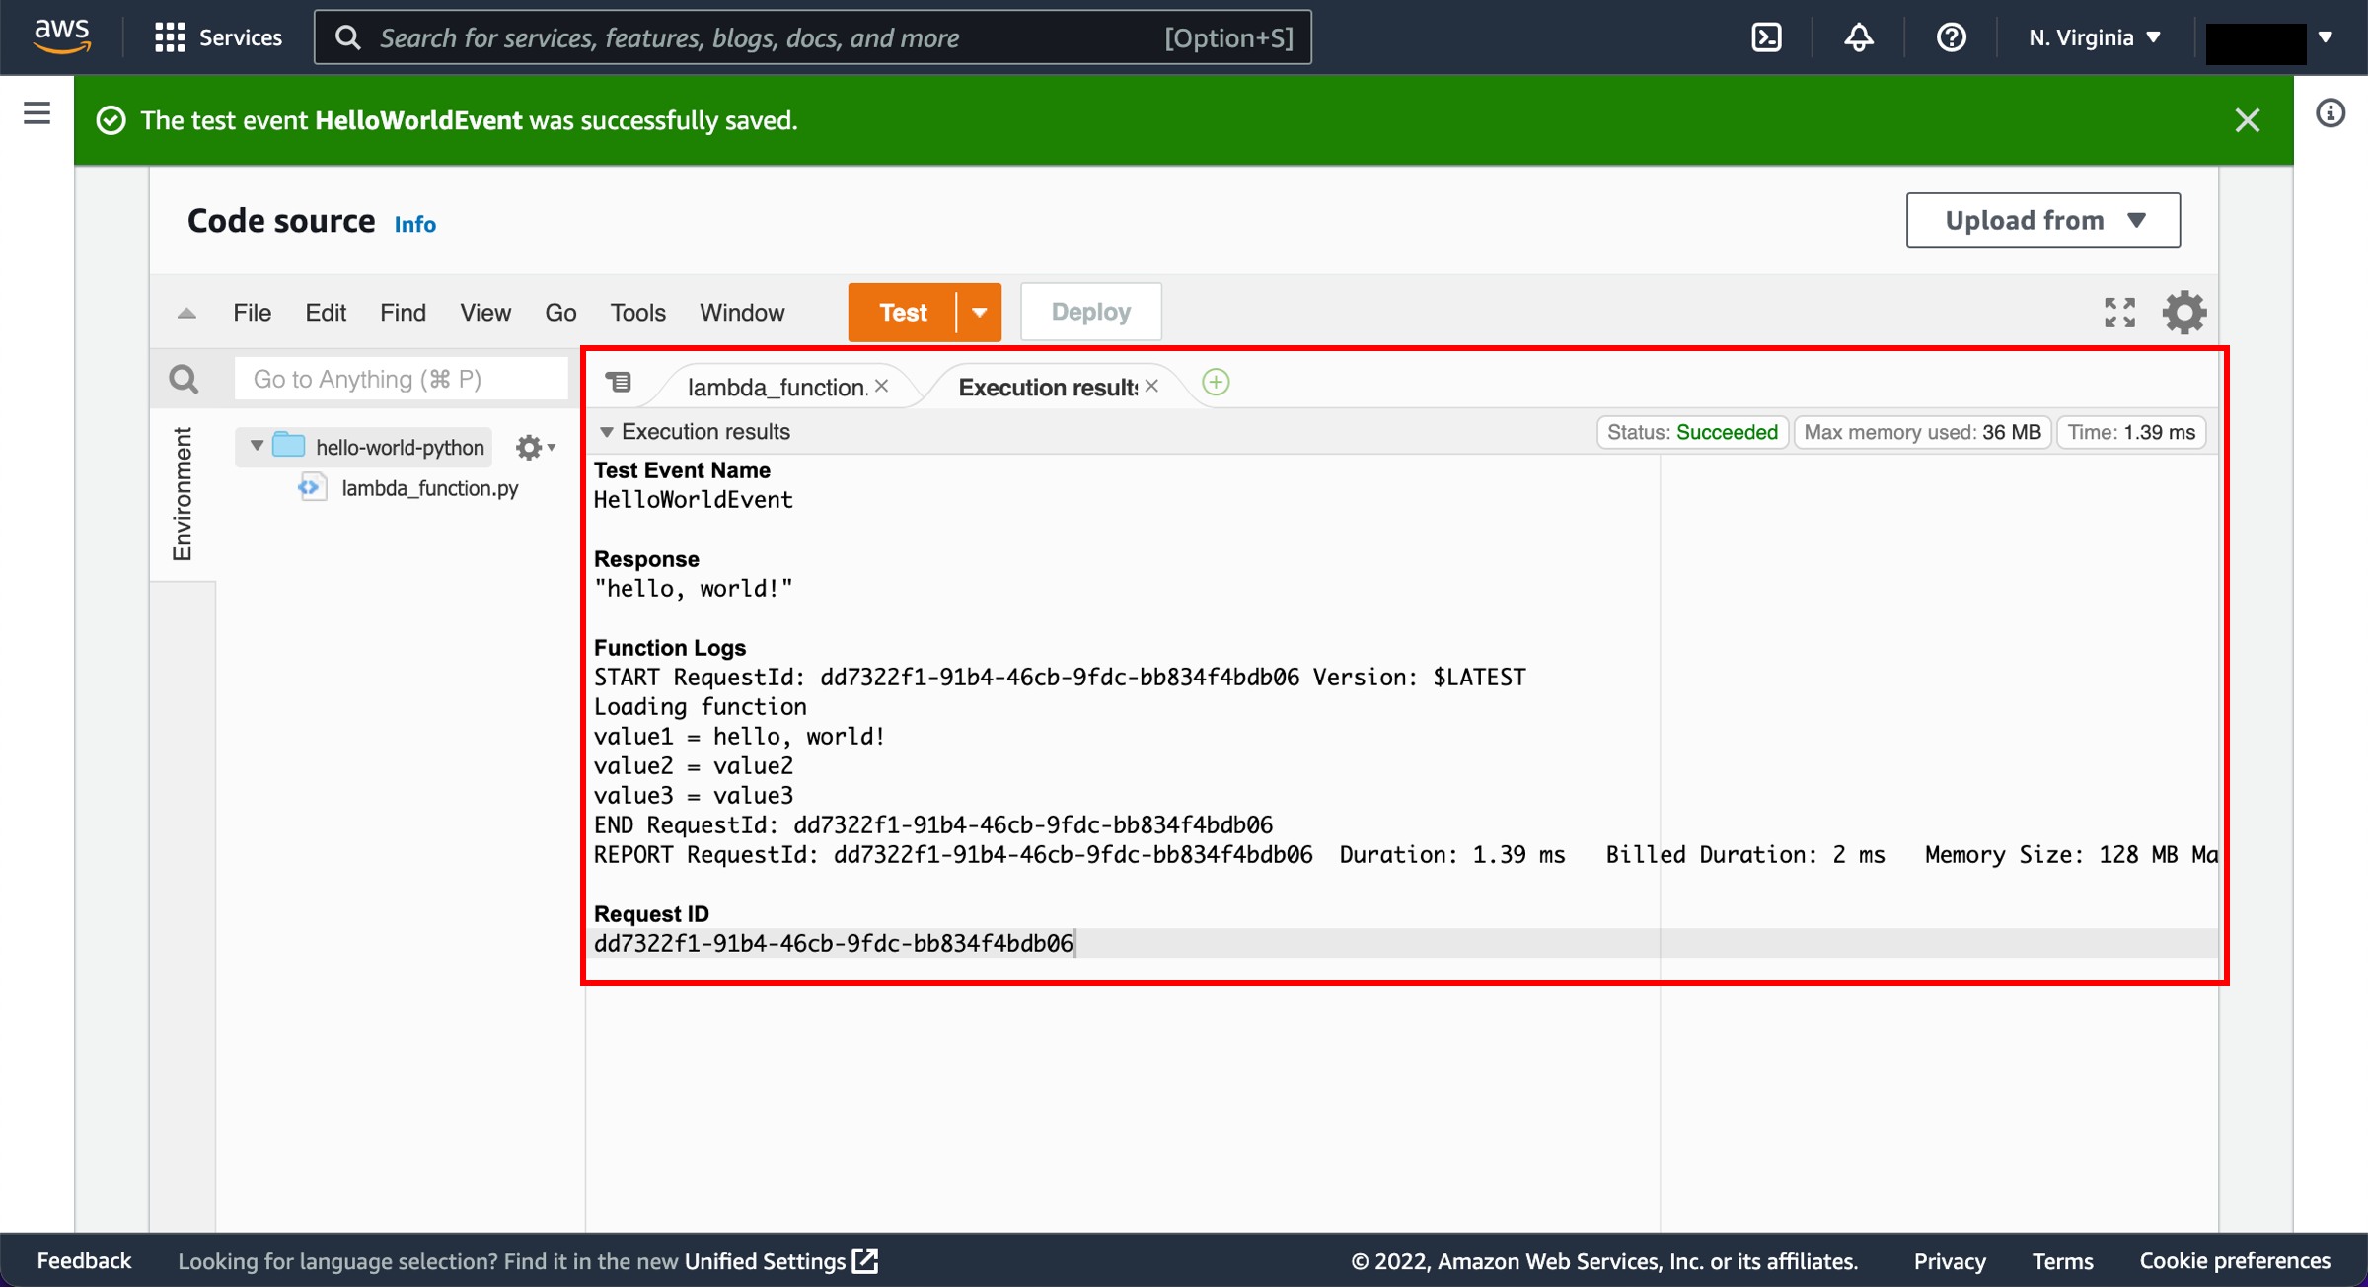
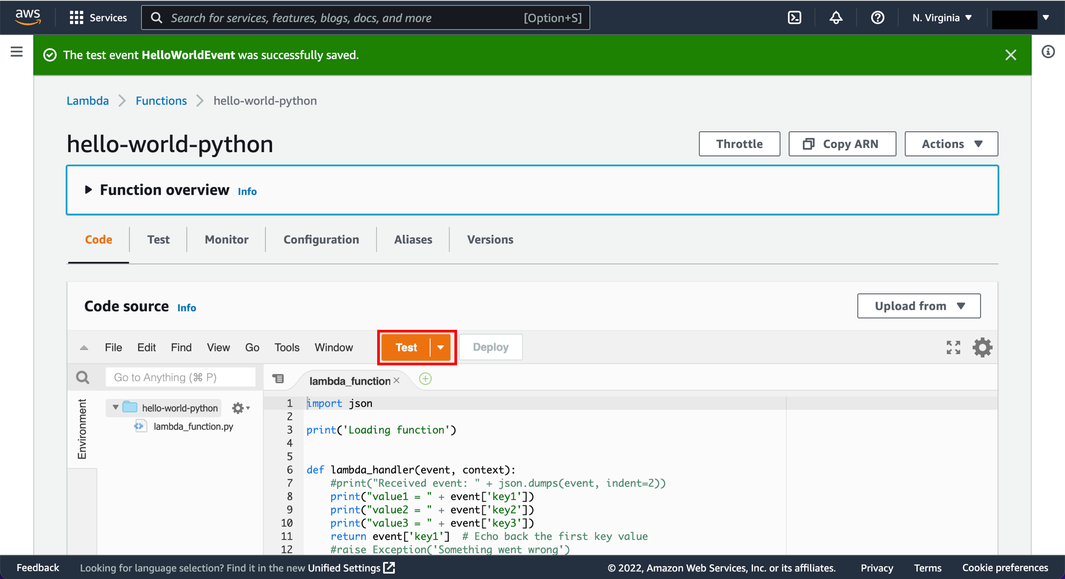
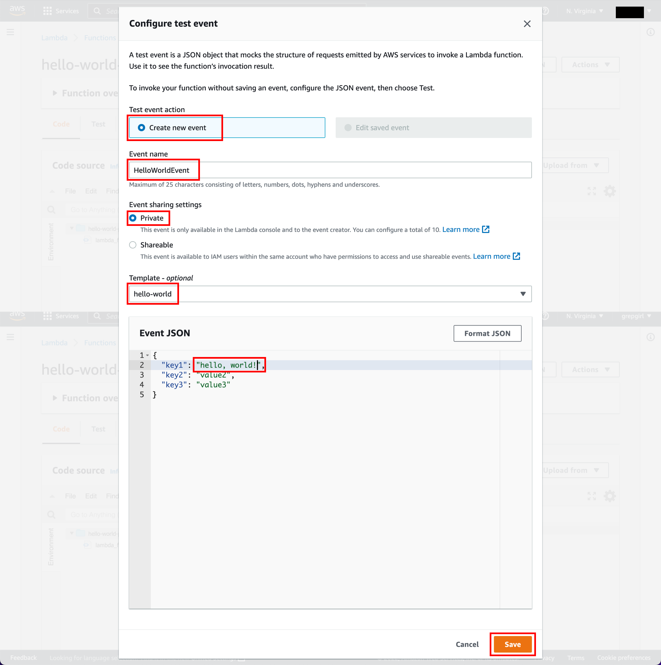
Run a Serverless “Hello, World!”
4. Invoke Lambda function and verify results
Notes:
Now you want to test your lambda function. For that, you need to select the configure test event which will bring up a pop up <click> in which we select the create new event, enter the event name, and enter the event json which is basically input values and save it.
<click>
Now click on save and then test.
<click>
We get an execution result tab in which you can see that in the function logs the outputs are loading function and the rest which correspond with the code that we had written in Python.

Slide 17
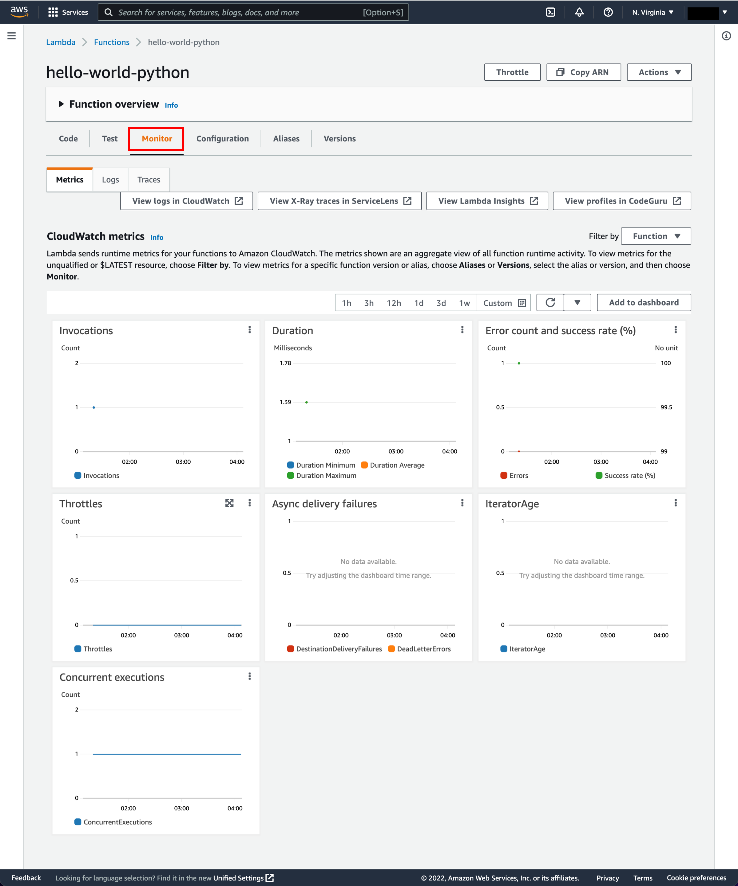
Run a Serverless “Hello, World!”
5. Monitor the Metrics
Notes:
Lambda automatically monitors Lambda functions and reports metrics through Amazon CloudWatch.
Select the Monitor tab to view the results. The Monitoring tab will show seven CloudWatch metrics: Invocations, Duration, Error count and success rate (%), Throttles, Async delivery failures, IteratorAge, and Concurrent executions.

Slide 18
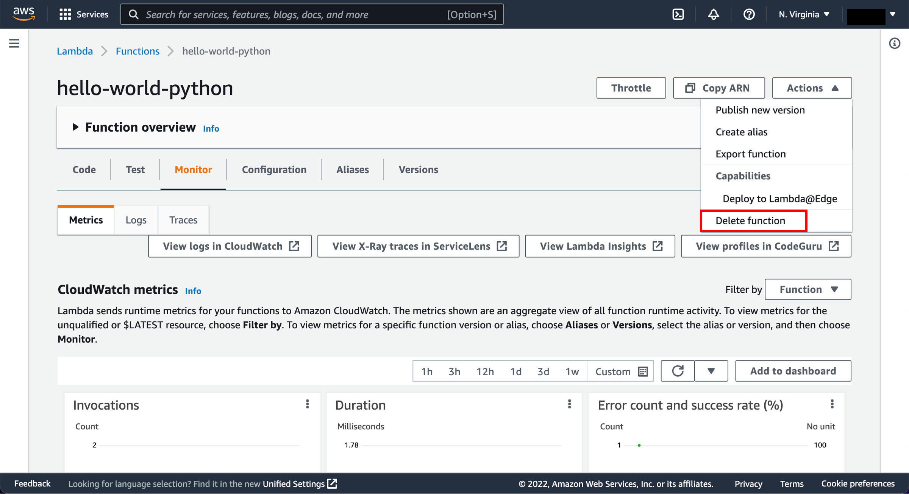
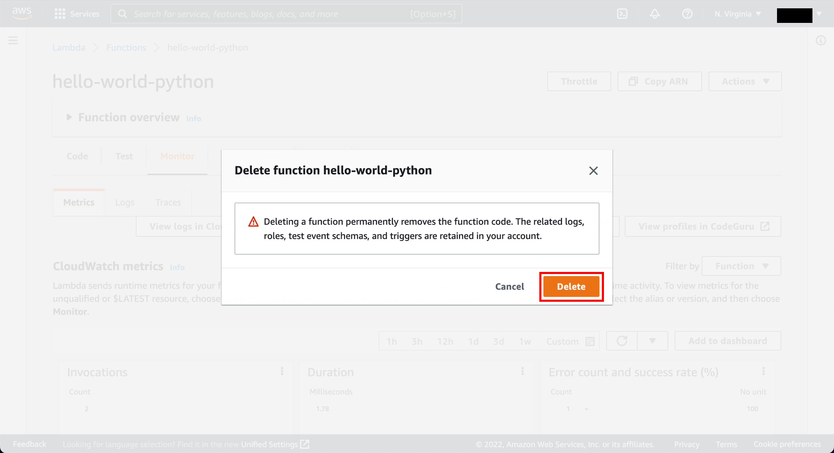
Run a Serverless “Hello, World!”
6. Deleting your Lambda function
Notes:
- To delete your lambda function, select delete function from the Action dropdown menu.
- <click>
- Click and delete and it's deleted!

Slide 19
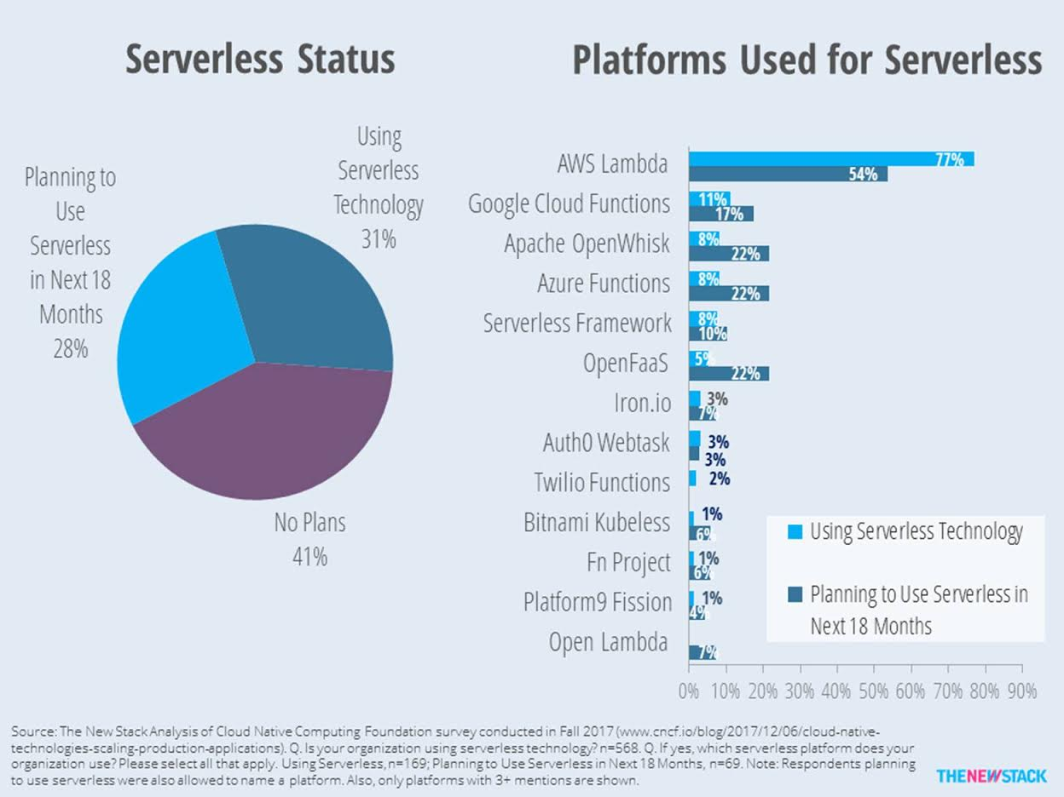
Why AWS Lambda for Microservices?
Cost-effective
Scalability
Security
Flexibility
Notes:
Cost-effective: Pay only for the compute time you consume.
Scalability: Automatically scale your application in response to incoming request traffic.
Security: AWS takes care of all the security patching, logging and monitoring.
Flexibility: Use the programming languages and frameworks you are already familiar with.

Slide 20
Ending Note
Microservices are a powerful and flexible way of building software systems, and AWS Lambda can be used to build and deploy them quickly and easily.
Lambda Features, the Execution Environment and Lifecycle
Boto3 + Lambda
How it Works: File processing & Web Application
Serverless “Hello, World!”
Why AWS Lambda.
Notes:
We got to know about the {whatever is written in the slide}.

Slide 21
Thank You

